Slide 1
Asset Pipeline
of Fools Engine
Work in progress

Slide 2
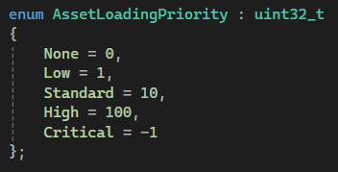
Runtime Management
Editor and Game
AssetsManager
Creates and manages ECSes
Decides what to load and what to unload
Storage structure:
Assets are broken down into components and stored in ECS (each asset type has its own - runtime ID may be identical for multiple assets as long, as they are different types).
This gives flexibility of allowing easy creation of asset subtypes (e.g. standalone mesh and mesh that is part of a model), connections and dependencies between assets without redesigning whole asset system or fighting with poorly predicted inheritance hierarchy. Lack of complex interactions between assets (only loading dependencies and similar) makes ECS perfect fit.
ECS
Centralized streaming:
You can never assume an asset is loaded and there is no explicit asset loading request possibility. Instead, a handle to the asset has a loading priority value - enum. Asset handles of each loading priority are atomically counted in a component of that asset (reference counting). Asset Manager uses those counts to decide centrally which assets to load and unload:
Calculates score of each asset as ∑ of count*priority
Sorts those scores
Unloads assets with score 0
Load as many assets as much memory is available
This makes dynamic adaptive asset loading management much easier and safer (e.g. preloading assets for next level simply by setting their handles from None to Low). Asset loading/unloading and score calculation/sorting runs in an asynchronous loop, but in a foreground (structured concurrency).

Slide 3
Access
Synchronization
Asset
Mutex A
Mutex B
Generic interface to ECS
Concrete Asset
Public only methods specific to its asset type
Can be conceptualized as an asset itself, but actually is just an interface to ECS
Atomic Observers Count
Texture : Asset
Shader : Asset
Observer() Lock Mutex A Observers Count ++ If 2. was 0->1 Lock Mutex B Unlock Mutex A | User() Lock Mutex A Lock Mutex B
~Observer() Observers Count -- If 1. was 1->0 Unlock Mutex B | ~User() Unlock Mutex B Unlock Mutex A
Material : Asset
Audio : Asset
AssetHandle<tnAsset>
AssetID + AssetLoadingPriority
.Use()
.Observe()
AssetUser<> : tnAsset
AssetObserver<> : tnAsset
Like unique_ptr
Like lock guard
Like shared_ptr
Like lock guard
Always const

Slide 4
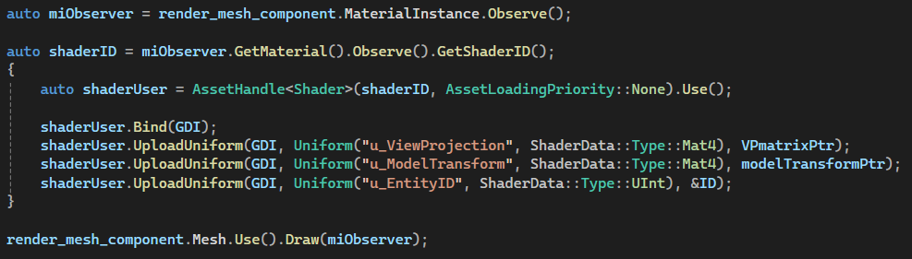
Synchronized Runtime Access
Examples
Use() and Observe() are chainable for convenience.
Synchronization is inline (beware of the cost!).
Dedicated scope to destroy shaderUser and release locks when its no longer needed
AssetHandle is constructible on the fly.
AssetHandles with AssetLoadingPriority::None are not globally counted – no hidden cost.

Slide 5
Geometry Assets
Material
Shader
Shader parameters (samplers, uniforms)
MaterialInstance
Material
N × Texture
Uniform Values
Mesh
Vertices and Indices
RenderMesh
Mesh
MaterialInstance
Model
N × RenderMesh
Skeleton
Hierarchy of transforms with default values (base pose)
SkinnedModel
Skeleton
Model
Skinning

